Slide 1


Database Systems
The Relational Data Model and Relational Database Constraints
Bushra
bushra@nu.edu.pk

Slide 2
Relational Model
first proposed by E. F. Codd in his seminal paper “A relational model of data for large shared data banks”
This paper is now generally accepted as a landmark in database systems.
The model has its theoretical basis in set theory and first-order predicate logic

Slide 3
Relations, Tuples, and Attributes
relational model represents the database as a collection of relations,
represented as a table with columns and rows
each row represents a collection of related values
represents a fact that typically corresponds to a real-world entity or relationship
Example, STUDENT table each row represents facts about a particular student entity.
The column names—Name, Student_number—specify how to interpret the data values in each row, based on the column each value is in.
Notes:
Informally, each relation resembles a table of values or, to some extent, a flat file of records.
It is called a flat file because each record has a simple linear or flat structure.
The table name and column names are used to help to interpret the meaning of the values in each row.
A relation is represented as a two dimensional table in which the rows of the table correspond to individual records and the table columns correspond to attributes. Attributes can appear in any order and the relation will still be the same relation, and therefore will convey the same meaning.

Slide 4
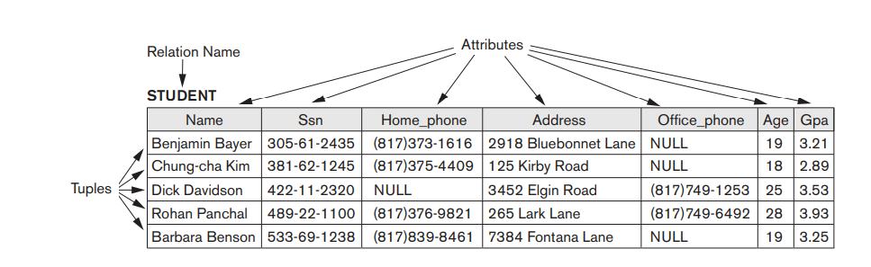
Relations, Tuples, and Attributes
In the formal relational model terminology,
a row is called a tuple,
a column header is called an attribute, and
the table is called a relation.

Slide 5
Domain
set of allowable values for one or more attributes.
domain D is a set of atomic values.
By atomic we mean that each value in the domain is indivisible in the formal relational model is concerned.
common method of specifying a domain is to specify a data type.
It is also useful to specify a name for the domain, to help in interpreting its values.
Examples:
cnic_numbers. The set of thirteen-digit numbers.
Age: Possible ages of employees in a company; each must be an integer value between 21 and 60.
Notes:
The data type describing the types of values that can appear in each column
The set of eleven-digit mobile numbers valid in Pakistan. (logical definitions of domains)

Slide 6
Domain
A data type or format is also specified for each domain.
Example, the data type for the domain mobile_numbers can be declared with format (dd)ddd-ddddddd, where each d is a numeric (decimal) digit.
A domain is thus given a name, data type, and format.
Additional information for interpreting the values of a domain can also be given;
Example, a numeric domain such as person_weights should have the units of measurement, such as pounds or kilograms.

Slide 7
Relation Schema
A relation schema R is used to describe a relation
is made up of a relation name R and a list of attributes
denoted by: R(A1, A2, … , An),
Where R is relation name and A1, A2, … , An is list of attributes.
Example: STUDENT(Name, Ssn, …)
Domain of Ai is denoted by dom(Ai).
dom(CNIC) = CNIC_TYPE.
Where CNIC_TYPE is the set of valid 13 digit CNIC number
Notes:
In the preceding definition, we showed assignment of generic types such as string or integer to the attributes. More precisely, we can specify the defined domains for some of the attributes of the relation
It is also possible to refer to attributes of a relation schema by their position within the relation; thus, the second attribute of the STUDENT relation is Ssn, whereas the fourth attribute is Address.

Slide 8
Relation Schema
The degree (or arity) of a relation is the number of attributes of its relation schema
Example: A relation of degree 3 would contain 3 attributes:
STUDENT(Name, Address, Age)
Using the data type of each attribute, the definition is sometimes written as:
STUDENT(Name: string, Address: string, Age: integer)

Slide 9
Relation State
A relation (or relation state) r of relation schema R is a set of n-tuples r = {t1, t2, … , tn}, also denoted by r(R)
Each tuple t is an ordered list of n values denoted by t =<v1, v2, … , vn>
E.g: t1 = <’Ali’, ‘7384 Fontana Lane’, 19> STUDENT relation
each value vi , 1 ≤ i ≤ n, is an element of dom (Ai) or NULL value.
e.g: v1 = ’Ali’ is a value of datatype string specified in domain
ith value in tuple t, corresponding to the attribute Ai , is referred to as t[Ai ] or t.Ai (or t[i] if we use the positional notation).
t1[Name]=Ali
relation intension is used for the schema R andrelation extension for a relation state r(R)

Slide 10
Relation in Set Theory
A relation (or relation state) r(R) is a mathematical relation of degree n on the domains is a subset of the Cartesian product of the domains that define R:
r(R) ⊆ (dom(A1) × dom(A2) × . . . × (dom(An))
The Cartesian product specifies all possible combinations of values from the underlying domains

Slide 11
Relation in Set Theory
if we denote the total number of values, or cardinality, in a domain D by |D|
the total number of tuples in the Cartesian product is
|dom(A1)| × |dom(A2)| × . . . × |dom(An)|
Of all these possible combinations, a relation state at a given time reflects only the valid tuples that represent a particular state of the real world
Notes:
This product of cardinalities of all domains represents the total number of possible instances or tuples that can ever exist in any relation state r(R).
In general, as the state of the real world changes, so does the relation state, by being transformed into another relation state.
However, the schema R is relatively static and changes very infrequently—for example, as a result of adding an attribute to represent new information that was not originally stored in the relation.

Slide 12
Roles
It is possible for several attributes to have the same domain.
The attribute names indicate different roles, or interpretations, for the domain.
Example, In STUDENT relation, the same domain phone_numbers plays the role of
Home_phone, referring to the home phone of a student,
Office_phone, referring to the office phone of the student.
Mobile_phone

Slide 13
Characteristics of Relation
Ordering of Tuples in a Relation
A relation is a set of tuples
a relation is not sensitive to the ordering of tuples
There is no preference for one ordering over another.
Notes:
Tuple ordering is not part of a relation definition and does not matter because a relation attempts to represent facts at a logical or abstract level.
A relation is defined as a set of tuples.
Mathematically, elements of a set have no order among them; hence, tuples in a relation do not have any particular order.
However, in a file, records are physically stored on disk (or in memory), so there always is an order among the records.
This ordering indicates first, second, ith, and last records in the file.
Similarly, when we display a relation as a table, the rows are displayed in a certain order. But there is no preference for one ordering over another..

Slide 14
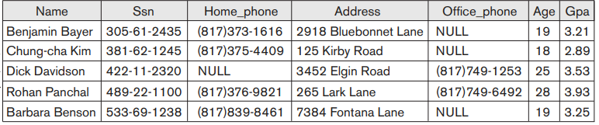
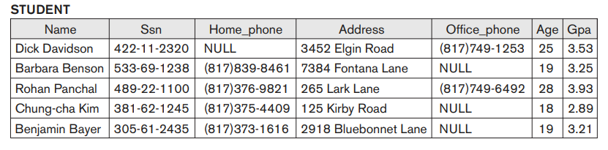
Ordering of Tuples in a Relation

Slide 15
Characteristics of Relation
Ordering of Values within a Tuple and an Alternative Definition of a Relation
the ordering of values in a tuple and hence of attributes in a relation schema is important.
STUDENT(Name: string, CNIC: string, Address: string, Age: integer)
t = <’Ali’, ‘41305-5138393-6’, ‘7384 Fontana Lane’,19>a

Slide 16
Ordering of Values within a Tuple
An alternative definition of a relation can be given, making the ordering of values in a tuple unnecessary
a tuple can be considered as a set of (attribute, value) pairs
t = < (Name, Ali),
(Address, 3452 Elgin Road),
(Age, 25),>
t = < (Address, 3452 Elgin Road),
(Name, Ali),
(Age, 25)>
a
Notes:
The ordering of attributes is not important, because the attribute name appears with its value both the tuples are identical
t = < (Name, Dick Davidson),(Ssn, 422-11-2320),(Home_phone, NULL),(Address, 3452 Elgin Road), (Office_phone, (817)749-1253),(Age, 25),(Gpa, 3.53)>
t = < (Address, 3452 Elgin Road),(Name, Dick Davidson),(Ssn, 422-11-2320),(Age, 25), (Office_phone, (817)749-1253),(Gpa, 3.53),(Home_phone, NULL)>
When the attribute name and value are included together in a tuple, it is known as self-describing data, because the description of each value (attribute name) is included in the tuple.
We will mostly use the first definition of relation, where the attributes are ordered in the relation schema and the values within tuples are similarly ordered, because it simplifies much of the notation.

Slide 17
Characteristics of Relation
Values and NULLs in the Tuples
Each value in a tuple is an atomic value.
NULL values are used to represent unknown or may not apply to a tuple or not available or undefined values of an attribute.
Interpretation (Meaning) of a Relation.
The relation schema can be interpreted as a declaration or a type of assertion.
Example, schema of STUDENT asserts that, in general, a student entity has a Name, Address and Age
Each tuple in the relation can then be interpreted as a fact or a particular instance of the assertion.
Notes:
Each value in a tuple is an atomic value; that is, it is not divisible into components within the framework of the basic relational model. Hence, composite and multivalued attributes are not allowed. This model is sometimes called the flat relational model.
For example
some STUDENT tuples have NULL for their office phones because they do not have an office (that is, office phone does not apply to these students).
Another student has a NULL for home phone, presumably because either he does not have a home phone or he has one but we do not know it (value is unknown).
In general, we can have several meanings for NULL values, such as value unknown, value exists but is not available, or attribute does not apply to this tuple (also known as value undefined).
An example of the last type of NULL will occur if we add an attribute Visa_status to the STUDENT relation that applies only to tuples representing foreign students.
It is possible to devise different codes for different meanings of NULL values.
The exact meaning of a NULL value governs how it fares during arithmetic aggregations or comparisons with other values.
For example, a comparison of two NULL values leads to ambiguities—if both Customer A and B have NULL addresses, it does not mean they have the same address.
During database design, it is best to avoid NULL values as much as possible
Interpretation
The relation schema can be interpreted as a declaration or a type of assertion.
Example, the schema of the STUDENT relation asserts that, in general, a student entity has a Name, Ssn, Home_phone, Address, Office_phone, Age, and Gpa.
Each tuple in the relation can then be interpreted as a fact or a particular instance of the assertion.
For example, the first tuple asserts the fact that there is a STUDENT whose Name is Benjamin Bayer, Ssn is 305-61-2435, Age is 19, and so on

Slide 18
Interpretation (Meaning) of a Relation.
some relations may represent facts about entities, whereas other relations may represent facts about relationships.
Example, a relation schema MAJORS (Student_ID, Department_code) asserts that students major in academic disciplines.
A tuple in this relation relates a student to his or her major discipline.

Slide 19
Relational Model Notation
uppercase letters Q, R, S denote relation names.
lowercase letters q, r, s denote relation states.
letters t, u, v denote tuples
An attribute A can be qualified with the relation name R by using the dot notation R.A
Example, STUDENT.Name
Both t[Au, Aw, … , Az] and t.(Au, Aw, … , Az), refer to the sub-tuple of values from t corresponding to the attributes specified in the list
Example: t[Ssn, Gpa, Age] = <‘533-69-1238’, 3.25, 19>.
Notes:
Relation name can qualify the attribute name. This is because the same name may be used for two attributes in different relations. However, all attribute names in a particular relation must be distinct
In general, the name of a relation schema such as STUDENT also indicates the current set of tuples in that relation—the current relation state—whereas STUDENT(Name, Ssn, …) refers only to the relation schema.

Slide 20
Summary
Informal Terms | Formal Terms
Table | Relation
Row | Tuple
Column header | Attribute
List of possible values for a column | Domain
Description of table | Relation Schema
Set of n tuples or row | Relation State

Slide 21
Relational Model Constraints
Various restrictions on data can be specified on a relational database in the form of constraints
Categories of constraints:
Model-based constraints or Implicit constraints
Constraints that are inherent in the data model.
The constraint that a relation cannot have duplicate tuples is an inherent constraint.
Characteristics of relations are the inherent constraints of the relational model
a

Slide 22
Categories of Constraints
Schema-based constraints or Explicit constraints:
Constraints that can be directly expressed in the schemas of the data model
Includes: Integrity Constraints such as : domain constraints, key constraints, entity integrity constraints and referential integrity constraints.
Application-based or Semantic constraints or Business rules
expressed and enforced by the application programs or in some other way.

Slide 23
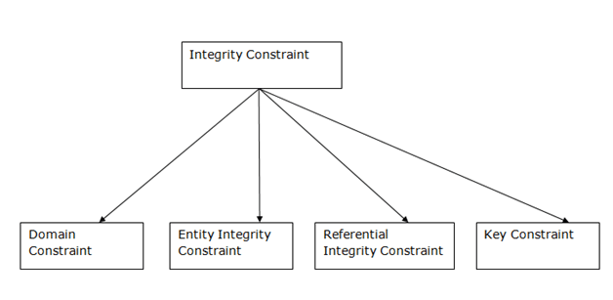
Categories of Constraints

Slide 24
Schema-based constraints or Explicit constraints
Domain Constraints
specify that within each tuple, the value of each attribute A must be an atomic value from the domain dom(A).
domains can be specified
with data types associated with domains
by a subrange of values from a data type
as an enumerated data type in which all possible values are explicitly listed

Slide 25
Key Constraints
all tuples in a relation must be distinct.
Superkey:
superkey SK is an attribute, or set of attributes, that uniquely identifies a tuple within a relation
specifies a uniqueness constraint
no two tuples should have the same combination of values for these attributes.
t1[SK] ≠ t2[SK] where SK is an attribute or set of attributes
Every relation has at least one default superkey— the set of all its attributes
Notes:
In the formal relational model, a relation is defined as a set of tuples. By definition, all elements of a set are distinct; hence, all tuples in a relation must also be distinct. This means that no two tuples can have the same combination of values for all their attributes
Suppose that we denote one such subset of attributes by SK; then for any two distinct tuples t1 and t2 in a relation state r of R, we have the constraint that t1[SK] ≠ t2[SK]
Any such set of attributes SK is called a superkey of the relation schema R.
A superkey SK specifies a uniqueness constraint that no two distinct tuples in any state r of R can have the same value for SK.

Slide 26
Superkey
However, a superkey may contain additional attributes or redundant attributes that are not necessary for unique identification
Student(Id, Name, Age, Address)
Id is a column which will have unique value for every student entity
{id} == SUPERKEY
{Id, Name} == is also a superkey.
Any set of attributes that includes Id is superkey
Notes:
Consider the STUDENT relation. The attribute set {Ssn} is a key of STUDENT because no two student tuples can have the same value for Ssn.
Any set of attributes that includes Ssn—for example, {Ssn, Name, Age}—is a superkey.
A superkey can have redundant attributes, however, so a more useful concept is that of a key, which has no redundancy.

Slide 27
Key
It is a minimal superkey
a superkey from which we cannot remove any attributes otherwise it will not satisfy the uniqueness constraint
Time invariant property
Example:
Student(Id, Name, Age, Address)
Attribute {Id} is a key of STUDENT
Any set of attributes that includes Id—for example, {Id, Name, Age}—is a superkey BUT NOT A KEY.
Thus a key can be superkey but not vice versa
Notes:
Hence, a key is a superkey but not vice versa.
A superkey may be a key (if it is minimal) or may not be a key (if it is not minimal)
However, the superkey {Ssn, Name, Age} is not a key of STUDENT because removing Name or Age or both from the set still leaves us with a superkey.
In general, any superkey formed from a single attribute is also a key. A key with multiple attributes must require all its attributes together to have the uniqueness property.
A key is determined from the meaning of the attributes, and the property is time-invariant: It must continue to hold when we insert new tuples in the relation.

Slide 28
Candidate Key and Primary Key
Candidate Key
relation schema may have more than one key.
each of the keys is called a candidate key.
Primary Key
One of the candidate keys can be primary key of the relation.
key whose values are used to identify tuples in the relation.
We use the convention that primary key attributes of a relation schema are underlined
The other candidate keys are designated as unique keys.
Notes:
Notice that when a relation schema has several candidate keys, the choice of one to become the primary key is somewhat arbitrary; however, it is usually better to choose a primary key with a single attribute or a small number of attributes.
The other candidate keys are designated as unique keys and are not underlined.

Slide 29
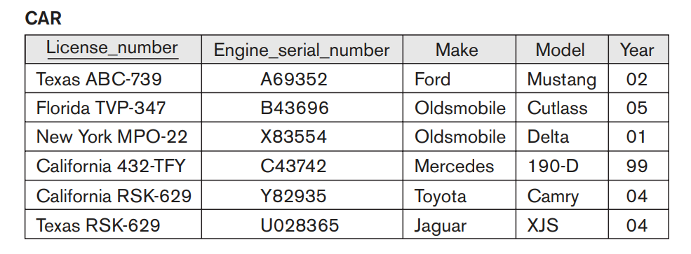
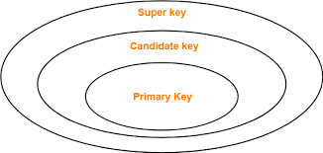
Candidate Key and Primary Key

Slide 30
Composite key
Composite key
When a key consists of more than one attribute, we call it a composite key
Not Null Constraint
specifies whether NULL values are or are not permitted.
Example, every STUDENT tuple must have a valid, non-NULL value for the Name attribute.
Notes:
Example, every STUDENT tuple must have a valid, non-NULL value for the Name attribute, then Name of STUDENT is constrained to be NOT NULL

Slide 31
Relational Database Schemas
A relational database schema S is a set of relation schemas S = {R1, R2, … , Rm} and a set of integrity constraints IC.
A relational database state DB of S is a set of relation states DB = {r1, r2, … , rm}
such that the ri relation states satisfy the integrity constraints specified in IC.
Example: relational database schema COMPANY = {EMPLOYEE, DEPARTMENT, DEPT_LOCATIONS, PROJECT, WORKS_ON, DEPENDENT}.
Each relational DBMS must have a data definition language (DDL) for defining a relational database schema.
Notes:
When we refer to a relational database, we implicitly include both its schema and its current state.
A database state that does not obey all the integrity constraints is called not valid, and a state that satisfies all the constraints in the defined set of integrity constraints IC is called a valid state.

Slide 32
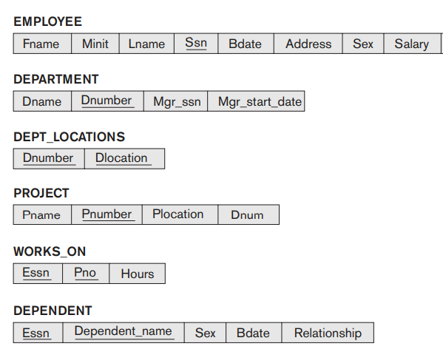
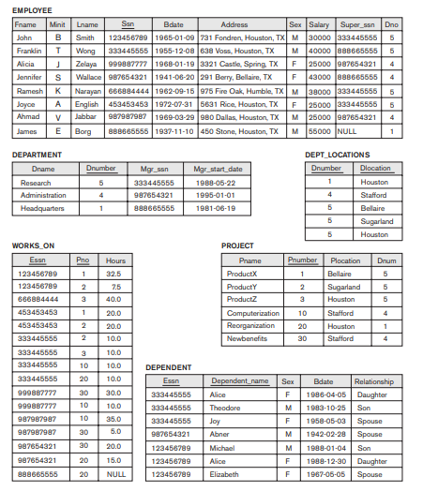
COMPANY relational database
Relational database Schema
Relational database State
Notes:
Here schema of one relation for example employee will be known as relation schema and
state of one relation such as employee will be known relation state

Slide 33
Entity Integrity Constraints
states that no primary key value can be NULL.
Key constraints and entity integrity constraints are specified on individual relations.
Example, if two or more tuples had NULL for their primary keys, we may not be able to distinguish them if we try to reference them from other relations
Notes:
The entity integrity constraint states that no primary key value can be NULL. This is because the primary key value is used to identify individual tuples in a relation. Having NULL values for the primary key implies that we cannot identify some tuples.
For example, if two or more tuples had NULL for their primary keys, we may not be able to distinguish them if we try to reference them from other relations.

Slide 34
Referential Integrity Constraints
is specified between two relations and is used to maintain the consistency among tuples in the two relations.
Informally, the referential integrity constraint states that a tuple in one relation that refers to another relation must refer to an existing tuple in that relation.
For example, Dno of EMPLOYEE relation must match some value in Dnumber of DEPARTMENT relation
Notes:
To define referential integrity more formally, first understand the concept of a foreign key.

Slide 35
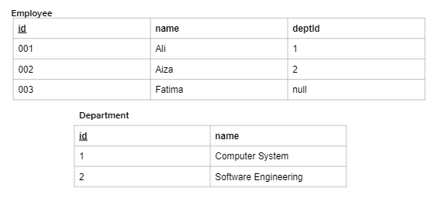
Referential Integrity Constraints
Foreign Keys
A FOREIGN KEY is a attribute (or collection of attributes) in one table, that refers to the PRIMARY KEY in another table.

Slide 36
Foreign Keys
FK of relation R1 that references relation R2 if it satisfies the following rules:
attributes in FK have the same domain(s) as the primary key attributes PK of R2;
the attributes FK are said to reference or refer to the relation R2.
A value of FK in a tuple t1 either occurs as a value of PK for some tuple t2 or is NULL.
t1[FK] = t2[PK], then tuple t1 references or refers to the tuple t2.
referential integrity constraints can be displayed by drawing a directed arc from each foreign key to the relation it references.

Slide 37
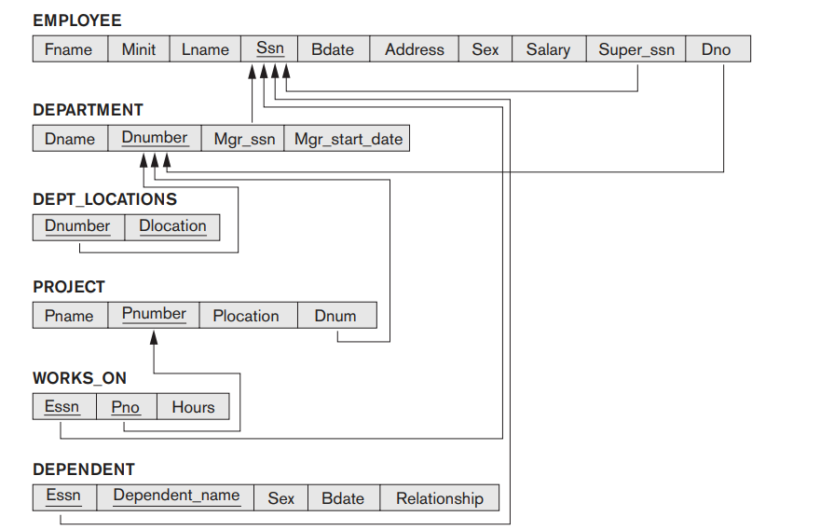
Referential integrity constraints on the COMPANY relational database schema.
Notes:
For clarity, the arrowhead may point to the primary key of the referenced relation

Slide 38
Referential Integrity Constraints
Notice that a foreign key can refer to its own relation.
Example, the attribute Super_ssn in EMPLOYEE refers to the supervisor of an employee; this is another employee, represented by a tuple in the EMPLOYEE relation.
Hence, Super_ssn is a foreign key that references the EMPLOYEE relation itself.
the DDL includes provisions for specifying the various types of constraints so that the DBMS can automatically enforce them.
Notes:
Another class of general constraints, sometimes called semantic integrity constraints, are not part of the DDL and have to be specified and enforced in a different way. Examples of such constraints are the salary of an employee should not exceed the salary of the employee’s supervisor and the maximum number of hours an employee can work on all projects per week is 56. Such constraints can be specified and enforced within the application programs that update the database, or by using a general-purpose constraint specification language. Mechanisms called triggers and assertions can be used in SQL, through the CREATE ASSERTION and CREATE TRIGGER statements, to specify some of these constraints

Slide 39
State Constraints and Transition Constraints
The types of constraints we discussed so far may be called state constraints because they define the constraints that a valid state of the database must satisfy.
Another type of constraint, called transition constraints, can be defined to deal with state changes in the database.
Example: “the salary of an employee can only increase.”
Such constraints are typically enforced by the application programs or specified using active rules and triggers in databases

Slide 40
Database Modification or Update Operations
operations of the relational model can be categorized into retrievals and updates.
three basic operations that can change the states of relations in the database: Insert, Delete, and Update (or Modify)
Whenever these operations are applied, the integrity constraints specified on the relational database schema should not be violated.
Notes:
In this section we discuss the types of constraints that may be violated by each of these operations and the types of actions that may be taken if an operation causes a violation

Slide 41
Database Modification or Update Operations
Insert
insert one or more new tuples in a relation
provides a list of attribute values for a new tuple t that is to be inserted into a relation R
Example Student(Name, Age, Id)
row to be inserted: T=<’Fatima’, 20, 001>
Insert can violate any of the four types of constraints. (domain, key, entity integrity, referential)
Notes:
Insert
Domain constraints can be violated if an attribute value is given that does not appear in the corresponding domain or is not of the appropriate data type.
Key constraints can be violated if a key value in the new tuple t already exists in another tuple in the relation r(R).
Entity integrity can be violated if any part of the primary key of the new tuple t is NULL.
Referential integrity can be violated if the value of any foreign key in t refers to a tuple that does not exist in the referenced relation.

Slide 42
Does these queries violate any constraint? If yes then which constraints?
Relation Schema:
Insert <‘Cecilia’, ‘F’, ‘Kolonsky’, NULL, ‘1960-04-05’, ‘6357 Windy Lane, Katy, TX’, F, 28000, NULL, 4> into EMPLOYEE.
Notes:
Answer: This insertion violates the entity integrity constraint (NULL for the primary key Ssn), so it is rejected.
In the first operation, the DBMS could ask the user to provide a value for Ssn, and could then accept the insertion if a valid Ssn value is provided.

Slide 43
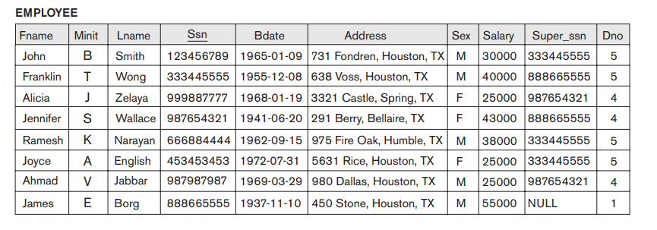
Does these queries violate any constraint? If yes then which constraints?
Insert <‘Alicia’, ‘J’, ‘Zelaya’, ‘999887777’, ‘1960-04-05’, ‘6357 Windy Lane, Katy, TX’, F, 28000, ‘987654321’, 4> into EMPLOYEE.
Notes:
Answer: This insertion violates the key constraint because another tuple with the same Ssn value already exists in the EMPLOYEE relation, and so it is rejected.

Slide 44
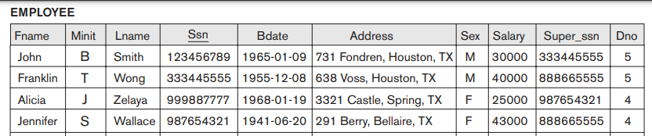
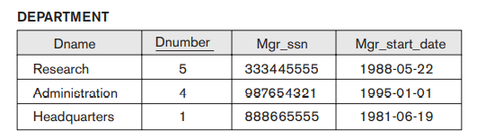
Does these queries violate any constraint? If yes then which constraints?
Insert <‘Alicia’, ‘J’, ‘Zelaya’, ‘999887777’, ‘1960-04-05’, ‘6357 Windy Lane, Katy, TX’, F, 28000, ‘987654321’, 7> into EMPLOYEE.
Notes:
Answer: This insertion violates referencial integrity constraints as we dont have any Dnumber 7 in department table

Slide 45
Database Modification or Update Operations
Actions that may be taken if insert causes a violation
The default option is to reject the insertion.
it would be useful if the DBMS could provide a reason to the user as to why the insertion was rejected.
Another option is to attempt to correct the reason for rejecting the insertion,
but this is typically not used for violations caused by Insert

Slide 46
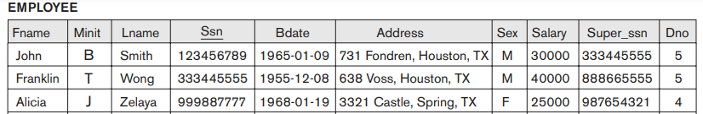
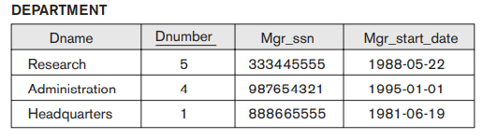
Delete operation
Delete can violate only referential integrity.
Is any constraint being violated in this query?
Query: Delete the Department tuple with Dnumber = 5
Notes:
This occurs if the tuple being deleted is referenced by foreign keys from other tuples in the database.
To specify deletion, a condition on the attributes of the relation selects the tuple (or tuples) to be deleted.

Slide 47
Database Modification or Update Operations
Actions that may be taken if delete causes a violation
Option 1: restrict, is to reject the deletion.
Option 2: cascade, is to attempt to cascade (or propagate) the deletion by deleting tuples that reference the tuple that is being deleted
Option 3: set null or set default, is to modify the referencing attribute values that cause the violation each such value is either set to NULL or changed to reference another default valid tuple.

Slide 48
Database Modification or Update Operations
Delete
Note: if a referencing attribute that causes a violation is part of the primary key, it cannot be set to NULL; otherwise, it would violate entity integrity.
Combinations of these three options are also possible
In general, when a referential integrity constraint is specified in the DDL, the DBMS will allow the database designer to specify which of the options applies in case of a violation of the constraint.

Slide 49
Database Modification or Update Operations
Update
The Update (or Modify) operation is used to change the values of one or more attributes in a tuple (or tuples) of some relation R.
Updating an attribute that is neither part of a primary key nor part of a foreign key usually causes no problems
the DBMS need only check to confirm that the new value is of the correct data type and domain
Modifying a primary key value is similar to deleting one tuple and inserting another in its place because we use the primary key to identify tuples.
Notes:
Hence, the issues discussed earlier in both Sections 5.3.1 (Insert) and 5.3.2 (Delete) come into play

Slide 50
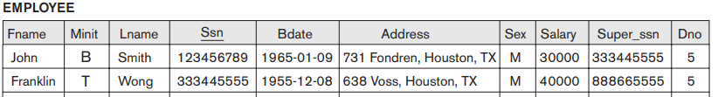
Does these queries violate any constraint? If yes then which constraints?
Update the salary of the EMPLOYEE tuple with Ssn = ‘123456789’ to 28000.
Notes:
Result: Acceptable.

Slide 51
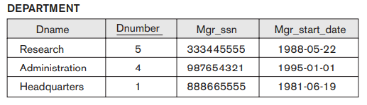
Does these queries violate any constraint? If yes then which constraints?
Update the Dno of the EMPLOYEE tuple with Ssn = ‘999887777’ to 7.
Notes:
Result: Unacceptable, because it violates referential integrity.
If a foreign key attribute is modified, the DBMS must make sure that the new value refers to an existing tuple in the referenced relation (or is set to NULL). Similar options exist to deal with referential integrity violations caused by Update as those options discussed for the Delete operation.
In fact, when a referential integrity constraint is specified in the DDL, the DBMS will allow the user to choose separate options to deal with a violation caused by Delete and a violation caused by Update

Slide 52
Does these queries violate any constraint? If yes then which constraints?
Update the Ssn of the EMPLOYEE tuple with Ssn = ‘999887777’ to ‘123456789’.
Notes:
Result: Unacceptable, because it violates primary key constraint by repeating a value that already exists as a primary key in another tuple;

Slide 53
Transaction
A transaction is an executing program that includes some database operations.
For example, a transaction to apply a bank withdrawal will typically
read the user account record,
check if there is a sufficient balance, and
then update the record by the withdrawal amount.
At the end of the transaction, it must leave the database in a valid or consistent state
Notes:
A transaction is an executing program that includes some database operations, such as reading from the database, or applying insertions, deletions, or updates to the database.
A large number of commercial applications running against relational databases in online transaction processing (OLTP) systems are executing transactions at rates that reach several hundred per second. Transaction processing concepts, concurrent execution of transactions, and recovery from failures

